Slide 1

Acetaminophen Overdose
Kari Bernhardt RN BSN CEN DNP-S
University of Mary
NUR 837: Acute and Emergent Problems
Dr. Suggs
March 29th, 2022

Slide 2
Objectives
01
02
03
04
Initial Approach
History & Diagnostics
Patient Management
Disposition
Providers initial approach to acetaminophen overdose
Pertinent positives and negatives necessary for accurate diagnosis
Diagnostic considerations & factors influencing management options
Determination of disposition, referral, and follow-up recommendations

Slide 3

Epidemiology
Widely available OTC and found in numerous cold, cough, and pain relief formulations
100,000 calls to poison control centers in the US annually
More hospitalizations for acetaminophen overdose than any other pharmacologic agent
  56,000 ED visits, 2,600 hospitalizations, and 500 deaths annually in the U.S.
28% mortality once acute liver failure presents & ½ require liver transplantation
Most common cause of liver transplantation in the U.S.
(Agrawal & Khazaeni, 2021; Burns et al., 2022)
Notes:
Acetaminophen is widely available and found it numerous products and people commonly underestimate its toxicity. Some people fail to recognize that acetaminophen is found in more than one medication they are using. If caught early, mortality rates are extremely low. Once acute liver failure develops, mortality is approx. 28% and a third of patients require liver transplantation

Slide 4
Pathophysiology
1
2
Therapeutic Ingestion
Overdose
Metabolism: Liver; CYP450
Onset: 30min-2hrs
Peak: 4hours
Half-Life: 2-4hrs
Excretion: urine
Metabolized by Liver; CYP-450
  90% into inactive and nontoxic glucuronide and sulfate conjugates
  <5% into reactive and toxic N-acetyl-p-benzoquinone-imine (NAPQI)
Glucuronide reduces NAPQI to a nontoxic metabolite → eliminated in urine
Saturation of nontoxic glucuronidation and sulfation pathways →
  Greater amount of acetaminophen metabolized to toxic NAPQUI
NAPQUI binds to intracellular proteins leading to cell death
(Agrawal & Khazaeni, 2021; Long, 2022)
Notes:
** After therapeutic ingestion → more than 90% is metabolized in the liver to inactive and nontoxic glucuronide and sulfate conjugates that are subsequently excreted in urine. → Less than 5% is metabolized by the cytochrome P-450 mixed function oxidase system to form the highly reactive and toxic intermediate N-acetyl-p-benzoquinone imine (NAPQI). → Glutathione quickly reduces NAPQI to a nontoxic metabolite that is eliminated in urine.
** After an overdose → normal nontoxic glucuronidation and sulfation pathways of metabolism become saturated, which allows more APAP to be metabolized by the cytochrome P-450 system to the toxic metabolite NAPQI. → Once available stores of glutathione are diminished, the highly reactive NAPQI binds to intracellular proteins, thereby beginning the cascade of events that lead to cell death. Oxidative drug metabolism by the cytochrome P-450 system to NAPQI is concentrated in zone III (the centrilobular area of the hepatic lobule)—hence the characteristic centrilobular necro- sis described with APAP toxicity.
Acetaminophen is rapidly absorbed from the gastrointestinal (GI) tract and reaches therapeutic levels in 30 minutes to 2 hours.
Overdose levels peak at 4 hours unless other factors could delay gastric emptying, such as a co-ingestion of an agent that slows gastric motility, or if the acetaminophen is in an extended-release form.
Acetaminophen has an elimination half-life of 2 hours, but can be as long as 17 hours in patients with hepatic dysfunction. It is metabolized by the liver, where it is conjugated to nontoxic, water-soluble metabolites that are excreted in the urine.

Slide 5
“Toxicity can occur following a single acute ingestion or through repeated ingestions of supratherapeutic amounts”
—Heard & Dart, 2022

Slide 6
Factors Influencing Toxicity
ETOH ingestion
Chronic Liver Disease
Use of medications & herbal products
Acute & chronic
prolonged half-life & low CYP-450 activity
Anticonvulsants & opioids
St. Johns wart, garlic & germander
Nutritional Status
Age
Tobacco
malnutrition and period of fasting
>40yr/old greater risk for failure; <5yr/old less susceptible to toxicity
increases oxidative metabolism, increases mortality
(Burns et al., 2022)
Notes:
A number of factors may influence the propensity of acetaminophen to cause hepatotoxicity through these mechanisms→
ETOH: alcohol is a substrate of CYP2E1… chronic ingestion depletes glutathione stores and synthesis
Medications: products that induce the CYP251 enzyme
Nutrition: In the fasting or malnourished state, glucuronidation of acetaminophen is reduced, which leads to enhanced microsomal metabolism and increased production of NAPQI
Age: Adults over 40 years of age have a greater risk of acute liver failure, liver transplantation, and death following overdose. Young children are probably protected via an increased supply and regeneration of glutathione and greater activity of conjugation enzymes. However, following repeated excessive acetaminophen doses, young children are no less susceptible to hepatic injury.
Tobacco: Tobacco smoke contains CYP1A2 inducers and increases oxidative metabolism

Slide 7

History & Physical
History:
Intent of use
  intentional or accidental?
Pattern of use
  Single or repeated doses
  Max dose: 4g/day adults & 90mg/kg/day peds
Time of ingestion
Form of medication ingested (SR/ER)
Presence of coingestants
Existence of comorbid conditions that predispose to development of hepatic injury
Physical:
abdominal pain/liver tenderness, nausea, vomiting, jaundice, hypotension, or ill appearing
Significant abnormalities in VS or clinical findings soon after ingestion should not be attributed to acetaminophen alone
(Agrawal & Khazaeni, 2021 Burns et al., 2022)
Notes:
Whenever possible, evaluation should include identification of the agents involved, assessment of severity, and prediction of toxicity. In all patients with suspected acetaminophen overdose, a history should be obtained to elicit the dose, intent of use (ie, suicidal or not), pattern of use (eg, single or repeated doses), time of the ingestion, presence of coingestants, and existence of comorbid conditions that may predispose to the development of hepatic injury (eg, alcohol use, Gilbert's disease, antiseizure medication use, recent fasting)

Slide 8
Presenting S&S
STAGE 3: 72-96hrs
STAGE 2: 24-72hrs
STAGE 1: 0-24hr
STAGE 4: 4d-2wks
**Failure to recognize and treat within 16 hours results in significant morbidity and mortality**
Recovery Phase
Pt who survive undergo complete liver regeneration
Lab abnormalities return to normal 5-7 days
Maximal Hepatotoxicity
Hepatic necrosis
Encephalopathy, jaundice, renal failure, coagulation defects, myocardial abnormalities
Death (cerebral edema, sepsis, multi-system failure, hemorrhage, ARDS
Onset of Hepatoxicity
RUQ abdominal pain
Mild increase in AST/ALT
Rise of INR and decrease in renal function
Asymptomatic
Normal vitals, PE, and labs
Minor & non-specific complaints (i.e. N/V)
(Bond et al., 2018; Long, 2022)
Notes:
Four stages of APAP poisoning.
The clinical manifestations of an APAP overdose arise from the hepatotoxicity and resultant complications. Patients, even those who eventually progress to fulminant hepatic failure, are initially asymptomatic. Significant abnormalities in vital signs or clinical findings that become evident soon after ingestion should not be attributed to APAP alone;

Slide 9
Differential Diagnosis
Acute Hepatitis A or B
Mushroom exposure (Amanita Phalloides)
Herbal preparation
Industrial chemicals
ACE inhibitors
Anabolic steroids
Statins
Methotrexate
Ketoconazole
Phenytoin
Valproic Acid
Calcium Channel Blockers
Reye Syndrome
Inborn errors of metabolism
**Other causes of liver damage**
(Long, 2022)

Slide 10
Evaluation and Diagnosis
CBC, CMP, BUN/Creatinine, serum bilirubin, PT/INR, AST/ALT, amylase, glucose & U/A
Serum Acetaminophen concentration
Toxicology Screening
(i.e. salicylates, opiates, ethanol, antidepressants)
Repeat/Serial Acetaminophen concentration
1
3
EVERY patient suspected of intention or unintentional overdose & applied to nomogram
Established toxicity or predicted based on H&P
2
4-hours after the reported time of ingestion & serial measurements
4
Intentional ingestions or unreliable histories
**An undetectable initial concentration must not be misinterpreted to mean that hepatotoxicity is not present. Pt must be observed & repeat concentration at 4-hours**
( Bond et al., 2018; Burns et al., 2022)
Notes:
Objective: diagnostic testing is used to assist the clinician in determining which patients are at risk for hepatotoxicity and thus requiring further treatment.
**Lab evaluation is essential for all patients with potential risk because of lack of reliable clinical manifestations early after ingestion

Slide 11
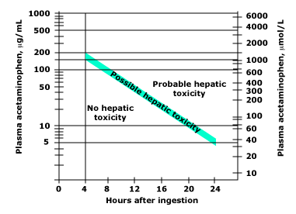
Rumack-Matthews Nomogram
Relationship between plasma acetaminophen concentration, the time after drug ingestion, and the risk of hepatic toxicity.
(Burns et al., 2022)
Notes:
The exact guidelines for the initiation of treatment vary throughout the world. The modified Rumack-Matthew treatment nomogram – Four-hour concentration of 150 mg/L have been used for many years and is preferred tool to guide treatment because of its safety and efficacy

Slide 12
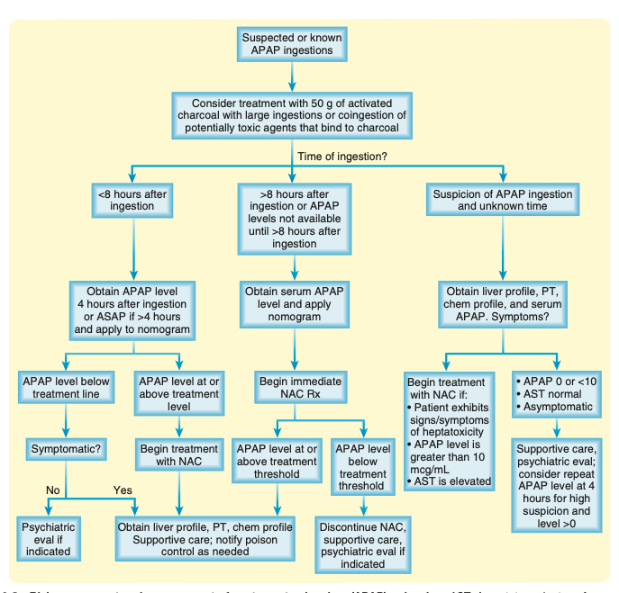
(Long, 2022)

Slide 13

Management Overview
Stabilization
Decontamination
N-Acetylcysteine Admin
Secure airway, breathing, and circulation if necessary; notify poison control
Give Activated charcoal 50g to all patients within 4 hours of ingestion
Pending APAP concentration and time of ingestion
(Heard & Dart, 2022)
Notes:
Most patient who present early, within 24 hours, are asymptomatic while others may require treatment for symptoms related to co-ingestants

Slide 14
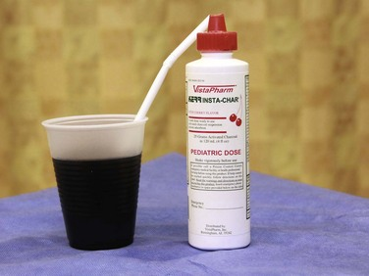
Gastrointestinal Decontamination
All patients after potentially toxic ingestion → single dose >7.5g
Tx: Activated Charcoal 1g/kg (max 50g) PO
  All patients who present within 4hrs of known or suspected ingestion
  Mechanism: reduces peak serum concentration thus decreasing number of pts requiring further treatment
Contraindications
  Sedation / unable to protect airway
  >4hrs unlikely beneficial
(Bond et al., 2018; Heard & Dart, 2022)
Notes:
Treatment with 50 g of activated charcoal should be considered in patients with large ingestions of APAP or coingestion of APAP and potentially toxic agents that bind to charcoal.2

Slide 15
Antidote:
N-acetylcysteine
Effectiveness
  Hepatotoxicity is uncommon and death is extremely rare if administered within 8hrs
Protocol
  12, 20, or 72hrs
  IV vs PO
    minimal difference in effectiveness
72-hr oral used in US for more than 30 years
  Loading dose 140mg/kg PO
  70mg/kg PO q4hrs for a total of 17 doses
Indications:
  Given to all patients at significant risk for hepatotoxicity
  Concentration drawn at 4hrs is above treatment line
  Suspected single ingestion >150mg/kg
  Unknown time of ingestion & serum concentration >10mcg/mL
  Evidence of liver injury
  Delayed presentation (>24hr)
(Bond et al., 2018; Heard & Dart, 2022)
Notes:
N-Acetylcysteine (NAC) is the antidote for APAP toxicity
If given within 8 hours of ingestion, the risk for significant hepatotoxicity secondary to APAP toxicity is low. There does not appear to be a significant advantage to administering NAC within the first 2 or 3 hours after ingestion over giving it later as long as it is within the 8-hour window
Patients initially seen longer than 8 hours after ingestion should be treated with NAC on arrival at the emergency department

Slide 16
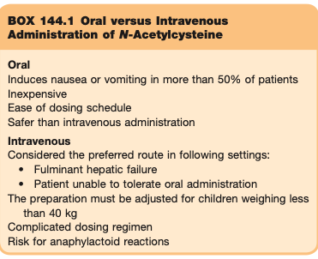
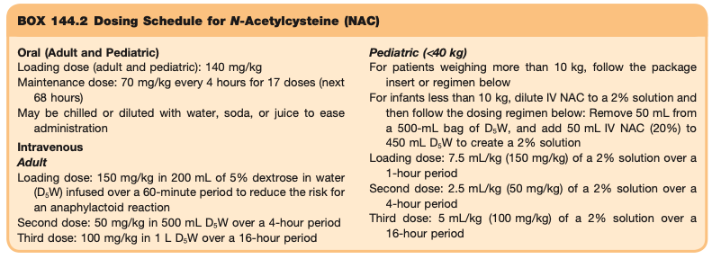
Special Consideration
(Long, 2022)

Slide 17
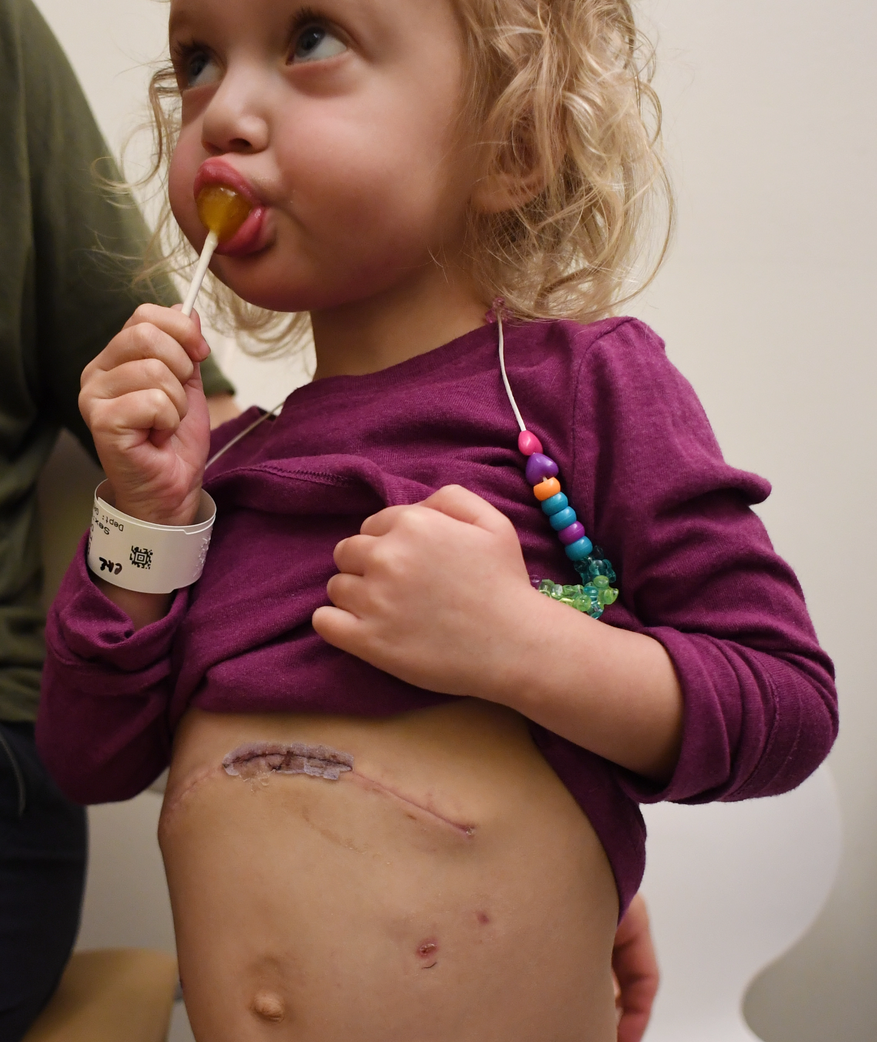
Liver Transplant
Last Resort . . .
Acute hepatic failure with complications
Renal failure,
Metabolic acidosis
Encephalopathy
Coagulopathy
Referral to a transplant surgeon and specialty center for consideration of liver transplantation
(Crone & DiMartini, 2014; Heard & Dart, 2022)

Slide 18
ICU Admission
Disposition
Discharge
Observe patient based on half-life, amount ingested, and formulation
Discharge→
    Unintentional ingestion
  Negative repeat serum concentration levels
  No s/s of hepatic injury
Admission
Risk for hepatotoxicity, toxic concentration levels, and/or intentional ingestion
Admission →
    Administration of NAC
    Routine laboratory evaluation
    Psychiatric evaluation (w/ intentional ingestion)
    Supportive care
Severe hepatotoxicity
      Elevated AST/ALT, prolonged PTT, increased BUN/Creatinine , acidosis, hypoglycemia
Hepatic encephalopathy or fulminant hepatic failure
Early contact with poison control and liver transplantation center
(Bakes et al., 2022; Long, 2022)

Slide 19
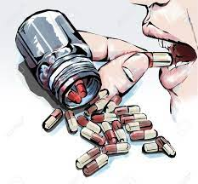
Key Points
Acetaminophen is available is numerous formulation including cold, cough, and pain relief medication
Acetaminophen toxicity may be clinically silent up to 24 hours after ingestion
Blood serum for acetaminophen should be collected 4 hours after ingestion
Apply serum results to nomogram to determine patient’s risk for toxicity
N-Acetylcysteine (NAC) is the antidote for acetaminophen poisoning
Approach to patient depends on timing of ingestion and serum APAP levels
If left untreated, may progress to liver failure & death
Psychiatry referral for ALL intentional overdoses

Slide 20
Reference
Agrawal, S., & Khazaeni, B. (2021). Acetaminophen toxicity. StatPearls, 85, 263–272. https://doi.org/10.1016/bs.apha.2018.12.004
Bakes, K. M., Buchanan, J. A., Moreira, M. E., Byyny, R., & Pons, P. T. (2022). Emergency Medicine Secrets (7th ed.). Elsevier.
Bond, G. R., Caravati, E. M., Dart, R. C., Heard, K., Hoffman, R. S., Rumack, B. H., & Snodgrass, W. R. (2018). Guidelines for the management of acetaminophen overdose [PDF]. tylenol professionals. https://www.tylenolprofessional.com/sites/tylenol_hcp_us/files/acetaminphen_overdose_treatment_info.pdf
Burns, M. J., Friedman, S. L., & Larson, A. M. (2020). Acetaminophen (paracetamol) poisoning in adults: Pathophysiology, presentation, and evaluation (S. J. Traub & J. Grayzel, Eds.). UpToDate. https://www.uptodate.com/contents/acetaminophen-paracetamol-poisoning-in-adults-pathophysiology-presentation-and-evaluation?search=Acetaminophen%20(paracetamol)%20poisoning%20in%20adults:%20Pathophysiology,%20presentation,%20and%20evaluation%26source=search_result&selectedTitle=1~150&usage_type=default&display_rank=1
Crone, C., & DiMartini, A. (2014). Liver transplant for intentional acetaminophen overdose: A survey of transplant clinicians׳ experiences with recommendations. Psychosomatics, 55(6), 602–612. https://doi.org/10.1016/j.psym.2014.02.004
Heard, K., & Dart, R. (2022). Acetaminophen (paracetamol) poisoning in adults: Treatment (S. J. Traub & J. Grayzel, Eds.). UpToDate. https://www.uptodate.com/contents/acetaminophen-paracetamol-poisoning-in-adults-treatment
Long, H. (2022). Acetaminophen, Aspirin, and NSAIDs. Clinical Key. https://www.clinicalkey.com/#!/content/book/3-s2.0-B9781437735482001440

